Slide 1

Detecting Impersonators in Examination Centres using AI
Under the Guidance of
<Name of the Guide>, <Designation>
Department of Computer Science & Engineering
B V Raju Institute of Technology, Narsapur
Presented by
<Name of the student>, <Roll Number>
<Name of the student>, <Roll Number>
<Name of the student>, <Roll Number>
<Name of the student>, <Roll Number>

Slide 2
Abstract
Abstract
Introduction
Existing System
Proposed System
Software & Hardware Requirements
Architecture
Modules
Data Flow Diagrams/Algorithms/Techniques
References
Detecting impersonators in examination halls is important to provide a better way of examination handling system which can help in reducing malpractices happening in examination centres.
In this project we are developing an AI system where images of students are collected with names and hall ticket numbers are pre-trained using the KDTree algorithm and the model is saved. Whenever a student enters into classroom, the student should look at the camera and enter class, after the given time or class is filled with student’s information will store in a video file with student name

Slide 3
Abstract
Abstract
Introduction
Existing System
Proposed System
Software & Hardware Requirements
Architecture
Modules
Data Flow Diagrams/Algorithms/Techniques
References
The video will have a user with hall ticket no and name on each face. If admin finds any unknown user tag on face admin can recheck and trace impersonators.

Slide 4
Abstract
Introduction
Existing System
Proposed System
Software & Hardware Requirements
Architecture
Modules
Data Flow Diagrams/Algorithms/Techniques
References
Abstract
Introduction
Existing System
Proposed System
Software requirements
Architecture Model
Modules
UML Diagrams/ER Diagrams/Flow Charts
References
Introduction
According to the latest news reports, 56 JEE candidates who are potential impersonators were detected by a national testing agency.
In order to solve this problem, an effective method is required with less manpower. With the advancement of machine learning and AI technology, it is easy to solve this problem.
Lately the proliferation of social networks has given rise to a myriad of fraudulent strategies aimed at getting some sort of benefit from the attacked individual. Despite most of them being exclusively driven by economic interests, the so called impersonation, masquerading attack or identity fraud hinges on stealing the credentials of the victim and assuming his/her identity to get access to resources

Slide 5
Introduction
Existing System
Proposed System
Software requirements
References
Abstract
Introduction
Existing System
Proposed System
Software & Hardware Requirements
Architecture
Modules
Data Flow Diagrams/Algorithms/Techniques
References
Existing System
Information given in the hall ticket is used as verification to check if student is exact person or not. Manual security checks are performed with are not perfect and some time students can change image from hall ticket.

Slide 6
Introduction
Existing System
Proposed System
Software requirements
References
Abstract
Introduction
Existing System
Proposed System
Software & Hardware Requirements
Architecture
Modules
Data Flow Diagrams/Algorithms/Techniques
References
Proposed System
In proposed system initially images of each student are collected and each dataset consists of 50 images of each student. These images are trained using kdtree algorithm using image processing technique and model is saved in system this model can be used for automatic prediction of student in exam halls from live video or images.

Slide 7
Introduction
Existing System
Proposed System
Software requirements
References
Abstract
Introduction
Existing System
Proposed System
Software & Hardware Requirements
Architecture
Modules
Data Flow Diagrams/Algorithms/Techniques
References
Disadvantages:
Manual verification methods are used for checking personally for each student which is not possible to check each student personally.
Chances of changing images from hall ticket is possible which doesn’t have verification method.

Slide 8
Introduction
Existing System
Proposed System
Software Requirements
References
Abstract
Introduction
Existing System
Proposed System
Software & Hardware Requirements
Architecture
Modules
Data Flow Diagrams/Algorithms/Techniques
References
Software & Hardware Requirements
HARDWARE REQUIREMENTS:
System : intel core i3
Hard Disk : 500 GB.
Monitor : 15 VGA Color.
Mouse : Logitech.
RAM : 2 GB.

Slide 9
Introduction
Existing System
Proposed System
Software Requirements
References
Abstract
Introduction
Existing System
Proposed System
Software & Hardware Requirements
Architecture
Modules
Data Flow Diagrams/Algorithms/Techniques
References
Software & Hardware Requirements
SOFTWARE REQUIREMENTS:
Operating system : Windows XP/7/10
Coding Language : python
Development Kit : anaconda
Library : keras, OpenCV
Dataset : any student’s dataset

Slide 10
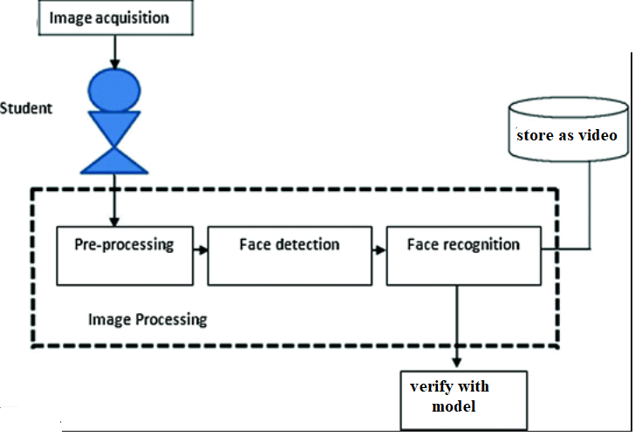
Architecture
Abstract
Introduction
Existing System
Proposed System
Software & Hardware Requirements
Architecture
Modules
Data Flow Diagrams/Algorithms/Techniques
References

Slide 11
Modules
Abstract
Introduction
Existing System
Proposed System
Software & Hardware Requirements
Architecture
Modules
Data Flow Diagrams/Algorithms/Techniques
References
Data set collection:
Students data set can be collected manually whicle issusing halltickets and store in each folder. Minimum 30 to 50 images need to be collected rom each student.
Encoding Dataset:
In this stage face recognition, pickle, opencv, sklearn libraries are initialized and each image is looped from the folder using batching and multiprocessing.
load the input image and convert it from BGR
detect the (x, y)-coordinates of the bounding boxes
corresponding to each face in the input image
compute the facial embedding for the face

Slide 12
Modules
Abstract
Introduction
Existing System
Proposed System
Software & Hardware Requirements
Architecture
Modules
Data Flow Diagrams/Algorithms/Techniques
References
KDDTree algorithm:
Encoded images are given to kdd tree algorithm and model is saved in pickle format.
K-d tree data structure has been used as a data structure for overcoming increased processing times caused by the addition of features into the database. An alternative approach is establishing a balanced k-d tree
Prediction:
In this stage input values are taken from image or video and compared with model and results are predicted and output is stored in image or video.

Slide 13
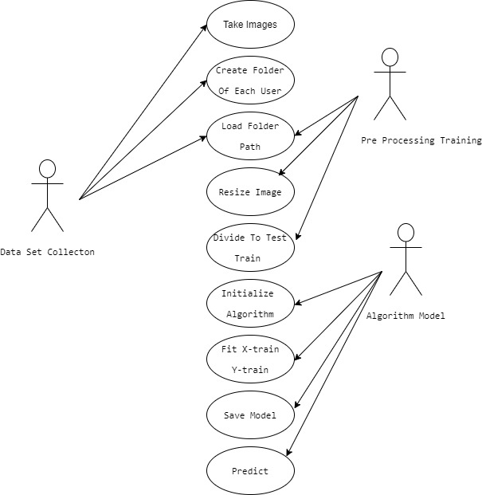
USE CASE DIAGRAM
Abstract
Introduction
Existing System
Proposed System
Software & Hardware Requirements
Architecture
Modules
Data Flow Diagrams/Algorithms/Techniques
References

Slide 14
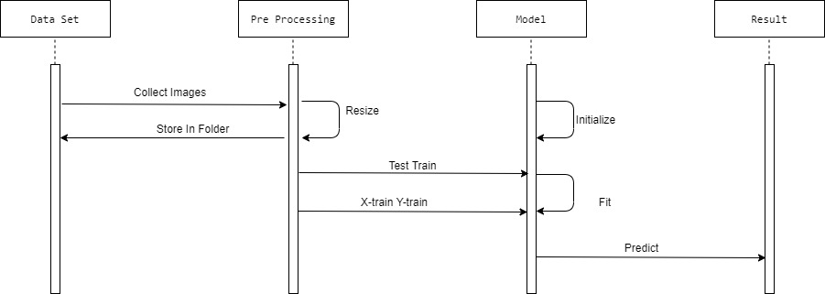
SEQUENCE DIAGRAM
Abstract
Introduction
Existing System
Proposed System
Software & Hardware Requirements
Architecture
Modules
Data Flow Diagrams/Algorithms/Techniques
References

Slide 15
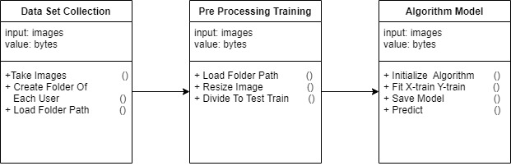
CLASS DIAGRAM
Abstract
Introduction
Existing System
Proposed System
Software & Hardware Requirements
Architecture
Modules
Data Flow Diagrams/Algorithms/Techniques
References

Slide 16
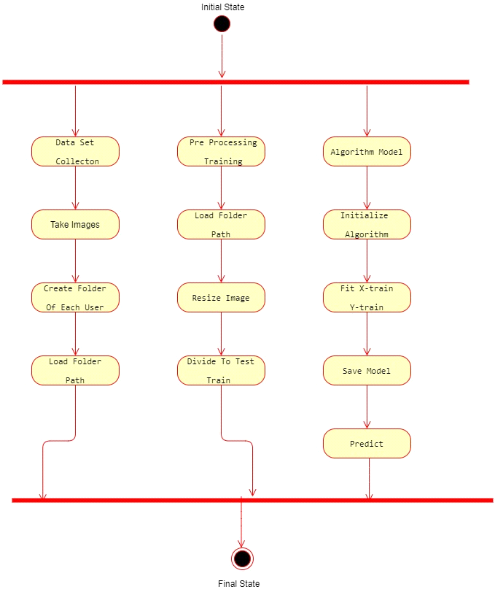
ACTIVITY DIAGRAM
Abstract
Introduction
Existing System
Proposed System
Software & Hardware Requirements
Architecture
Modules
Data Flow Diagrams/Algorithms/Techniques
References

Slide 17
Introduction
Existing System
Proposed System
Software requirements
References
Abstract
Introduction
Existing System
Proposed System
Software & Hardware Requirements
Architecture
Modules
Data Flow Diagrams/Algorithms/Techniques
References
References
M.S.U.Sarwar, A. Sharin, M.R. Khan, H.Imtiaz, S.A. Fattah, “A face recognition scheme based on spatial correlation function,” IEEE Region 10 Conference, pp. 671-674, 2010.
[2] P.N. Belhumeur, J.P. Hespanha, and D.J. Kriegman, “Eigenfaces vs Fisherfaces: recognition using class specific linear projection,” IEEE Trans. on Pattern Analysis and Machine Intelligence, 28(12), pp 2037-2041, 2006.
[3] M.I.Razzak, M.K.Khan, K.Alghathbar, R.Yousaf, “Face recognition using layered linear discriminant analysis and small subspace,” Proceedings of IEEE 10th International Conference on Computer and Information Technology, pp. 1407-1412, 2010.
[4] H.M.EI-Bakry, M.Hamada, “Fast principal component analysis for face detection using cross-correlation and image decomposition,” Proceedings of the International Conference on Neural Networks, pp. 148-153, 2009.
[5] Z.Shi, J. Hu, “Local linear discriminant analysis with composite kernel for face recognition,” Proceedings of the International Joint Conference on Neural Networks, pp. 1-5, 2012.
2/1

Slide 18
Thank you
Any Questions?

